Slide 1

Introduction to Computer Systems
Memory Systems
Direct Link to view these slides on Google Docs

Slide 2
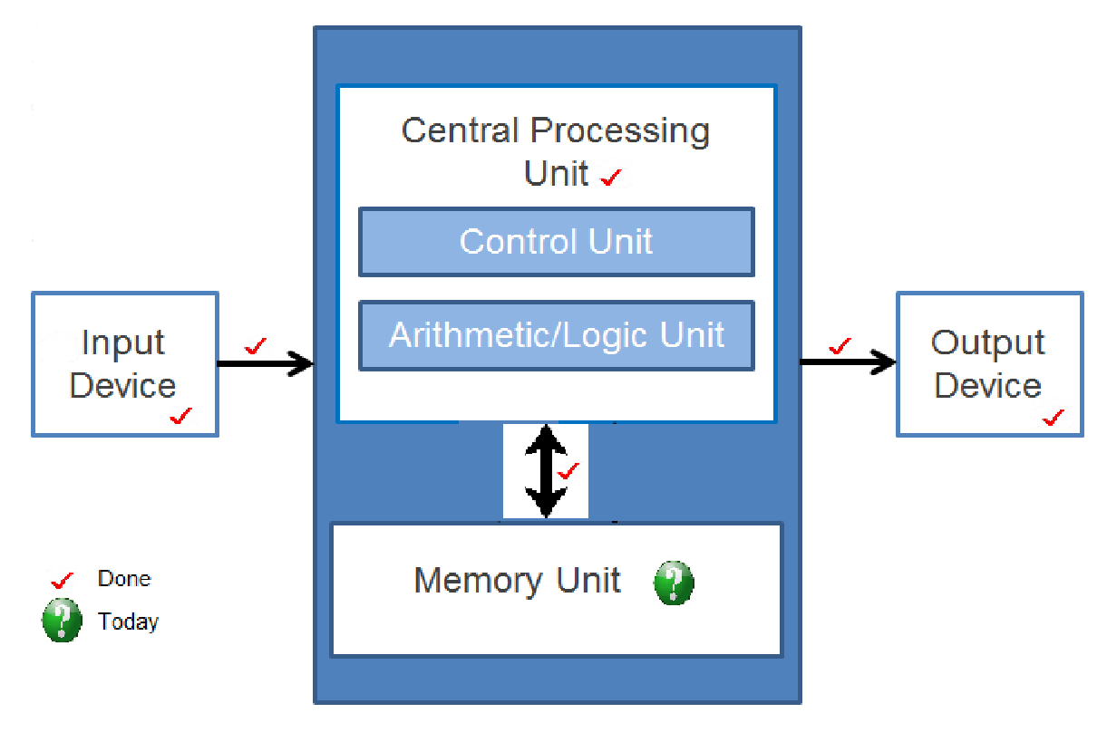
Computer Architecture (Von Neumann)

Slide 3
What to expect in this topic:
Memory Systems
Memory Hierarchy
Memory Terminology
Average Access times

Slide 4
Memory Systems
Memory allows storage of both data and programs. Programs can then access and manipulate it.
Registers
Data for immediate use
instruction in instruction register
Address of next instruction in program counter register
Processor Registers (32 x 32 bits)
Cache Memory Lines (256 x 1024 bytes)
Caches
Store small amounts of data currently being used by processor

Slide 5
Memory Systems
Memory allows storage of both data and programs. Programs can then access and manipulate it.
Main memory
Stores large amounts of data for access by processor
Accessed by word
Processor Registers (32 x 32 bits)
Cache Memory Lines (256 x 1024 bytes)
Virtual memory (Next lecture)
Stores enormous amounts of data as if in main memory for access
Accessed by page (4K bytes?)
Main Memory Words (4G x 32 bytes)
Virtual Memory Pages (1G x 4096 bytes)

Slide 6
Memory Systems: Throughput
Memory operations (e.g. read/write) take different amounts of time
One memory operation does not need to finish before next operation starts
Memory operations can be pipelined
Latency and bandwidth restrictions are relevant to memory
Latency: time taken to complete a single operation
Throughput: rate of completing operations
Bandwidth: total rate of moving data between memory and processor

Slide 7
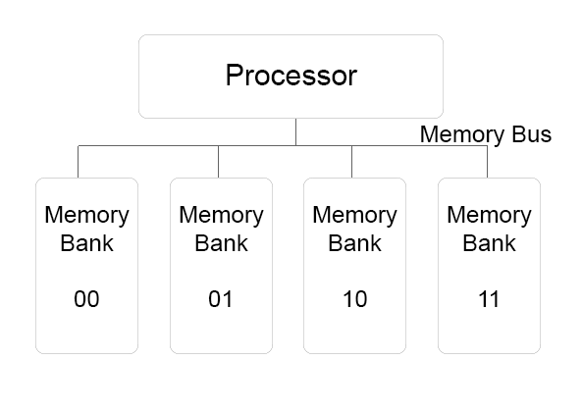
Pipelining & Precharging
Precharging: access memory before address arrives
Multiple memory references: requests can be sent to idle memory banks while waiting for earlier requests to complete
Banked system: data interleaved across different memory banks using least significant bits

Slide 8
Memory Hierarchy
Logical view as seen by programmer
Working data is held in registers – fast
Other data transferred to and from main memory more slowly
Processor
Memory

Slide 9
Memory Hierarchy
Processor
Cache
Physical view as seen by system architect
Registers for fast access to working data
Cache memory holds copies of main memory being used
Main memory holds actively used data
Virtual memory creates the illusion to users of a very large (main) memory.
Main Memory
Virtual Memory

Slide 10
Memory Hierarchy
Processor
Cache
Processor makes memory access
If address is in cache
Access cache (cache Hit)
If address is not in cache (cache Miss)
Move block of main memory containing address to cache
Access cache again
If address not in main memory similar operation with virtual memory (disk)
Main Memory
Virtual Memory

Slide 11
Levels in Memory Hierarchy
Hierarchy implemented in different technologies Both hardware and software
Caches: usually SRAM – (assigned addresses: hardware)
Many modern machines have several levels of cache
Main: DRAM – (assigned addresses: software)
Virtual: on disk
Cache ↔ main memory transfers
Implemented in hardware
Main memory ↔ virtual memory transfers
Implemented in software

Slide 12
SRAM vs DRAM
 | SRAM | DRAM
Usage | Cache Memory | Main Memory
Speed | Very fast | Fast
Cost | Costly | Cheaper than SRAM
Density (size) | Low | High

Slide 13
Memory Terminology
Hit, miss, hit rate, miss rate
Address present in level being accessed is a Hit
Address not present in level – a miss
Replacement policy: decides which block are replaced when a miss causes a new block to be read into the cache
The data in the cache is called dirty data, if it is modified within cache but not modified in main memory.
Inclusion: if a block present at one level is present at all lower levels
Write-back: if written data is only written to the cache
Write-through: if written data is copied to lower levels of hierarchy (main memory/virtual)

Slide 14
Average Access Times
Access time = T_{hit} P_{hit} + T_{miss} P_{miss}
T_{hit} : time to resolve requests that hit at that level
P_{hit} : probability of hit at that level
Hit rate at lowest level is 1
Cache hit ratio = [cache Hits / (Cache Hits + Cache Misses)] x 100%

Slide 15
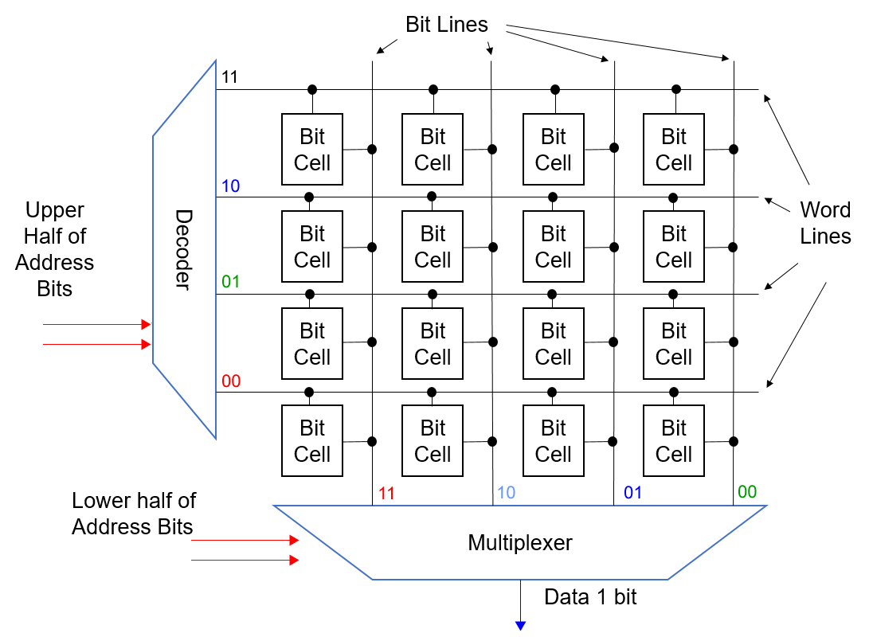
Memory Chip Organisation
Bit cells addressed by word lines and bit lines
Word line selected causes all but cells on that line to output their values
Multiplexer selects appropriate bit line

Slide 16
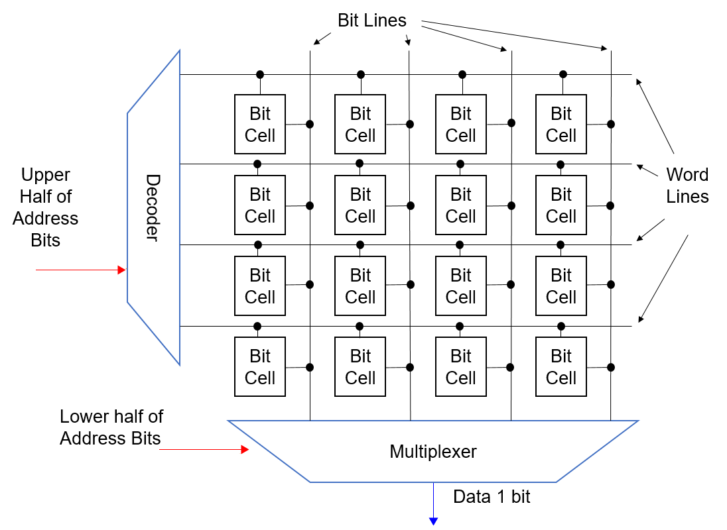
Memory Chip Organisation
4 bit address - access cell 1011

Slide 17
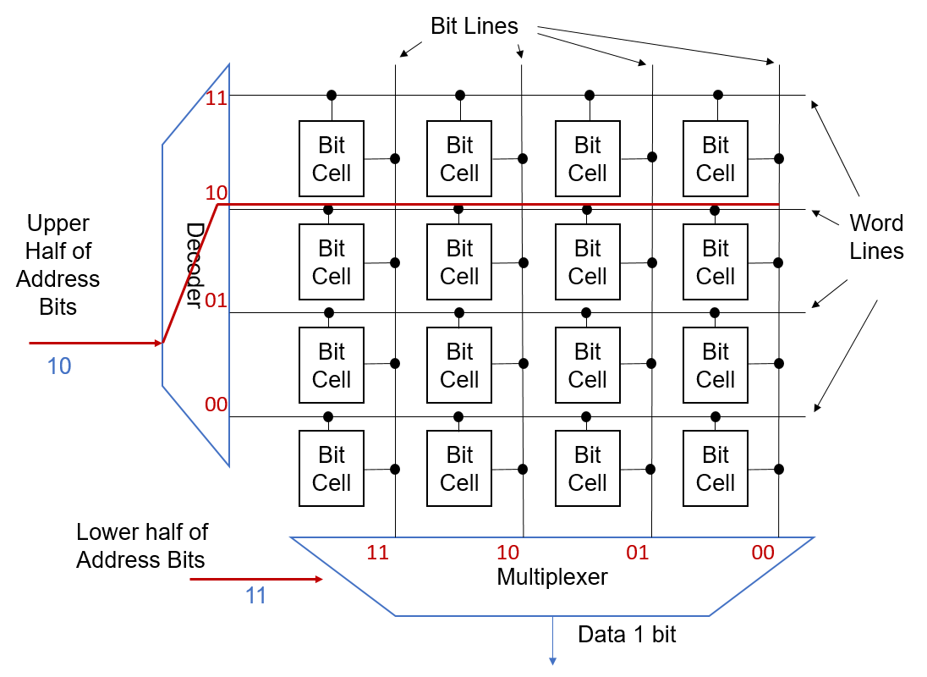
Memory Chip Organisation
4 bit address - access cell 1011
Top two bits activate all cells on that word line

Slide 18
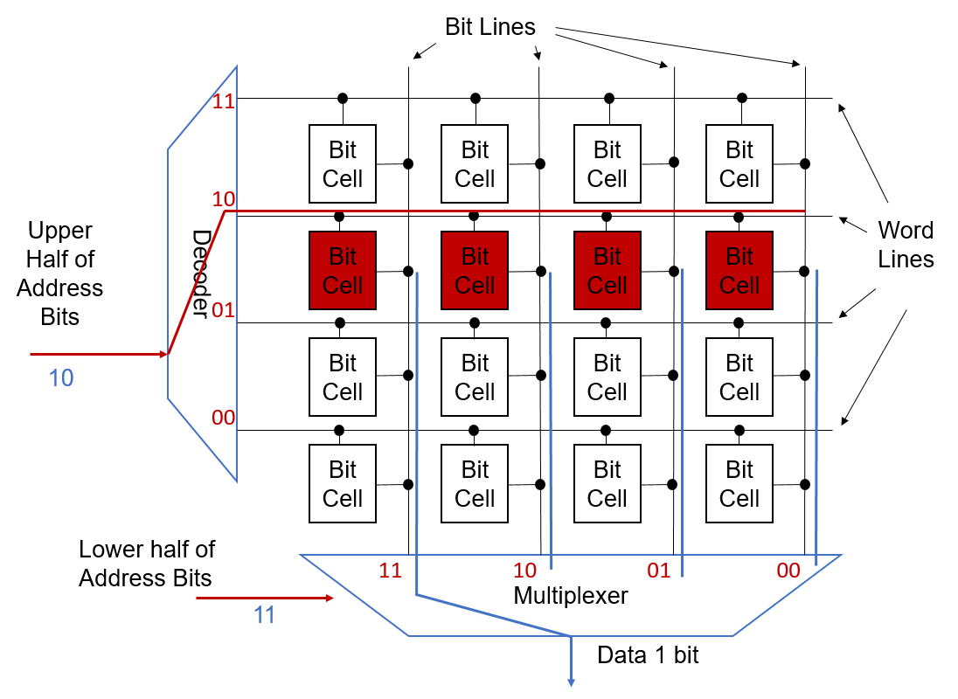
Memory Chip Organisation
4 bit address - access cell 1011
Top two bits activate all cells on that word line
All cells read out and bottom two bits select which cell’s content is delivered

Slide 19
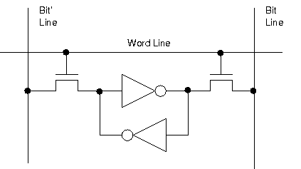
SRAM
Two inverters maintain value indefinitely: static
Read: assert word line and value transfers to bit lines
Write: put data on bit lines and assert word line

Slide 20
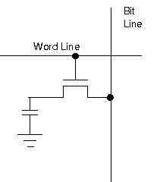
DRAM
Bit value stored in small capacitor (decays with time)
Less space on chip – signal weaker and slower
Refresh by reading data & writing back – (dynamic)

Slide 21
Caches
Cache: fast memory used to store data currently used by processor
Caches have hardware to track which addresses are currently in the cache
If address referenced by processor is in cache, data is brought from cache – a cache hit
Cache miss causes old data to be evicted (overwritten)
before the new data is brought into cache
then data returned to main memory

Slide 22
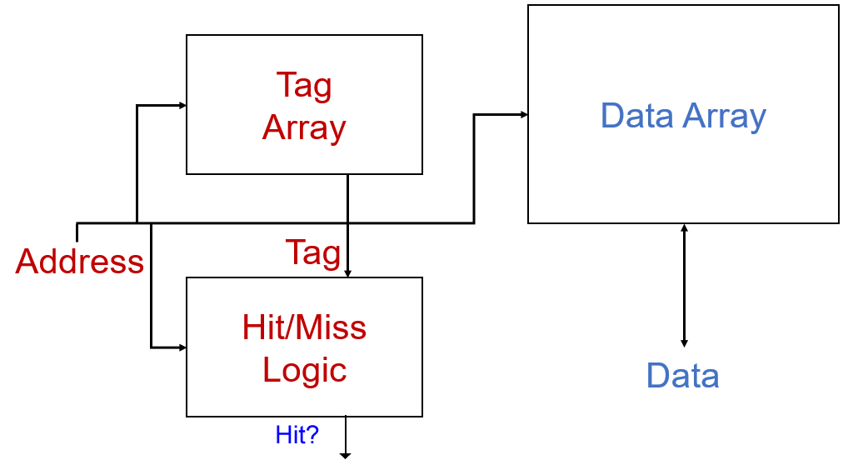
Caches
tag array: addresses in cache
data array: data corresponding to tags
hit/miss logic: compares tag and address to determine if cache data is valid

Slide 23
Cache Organisation
Caches organised as a set of data blocks known as cache lines
Line length is size of cache block
Lines are always aligned
Address of first byte is a multiple of line length
High order bits of address determine
Presence/absence from cache (hit or miss)
Line to use if address is present
Low order bits give offset within line
Long lines increase hit rate
Locality of reference
Long lines increase hit rate and slow cache because of larger quantity of data to read and evict

Slide 24
Cache Associativity
Associativity: how many lines in cache could contain address
High associativity
Large choice of lines for any address
Low miss rate
Complex hardware
Low associativity
Small choice of lines
Higher miss rate
Simpler hardware (easier choice for replacement)

Slide 25
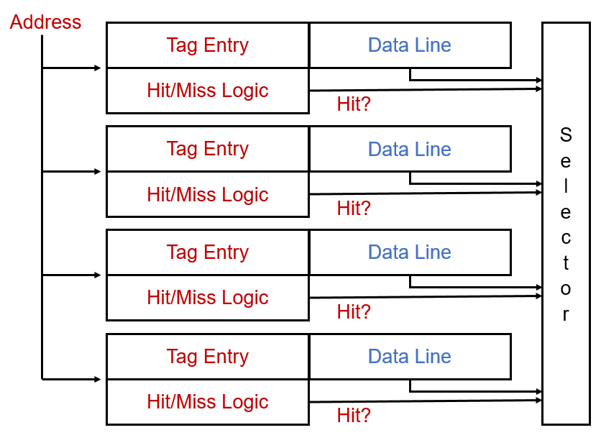
Fully Associative Cache
Any address can be stored in any line
Address of request is compared to each entry in tag array
Hit: select appropriate data from line
Miss: invoke replacement policy

Slide 26
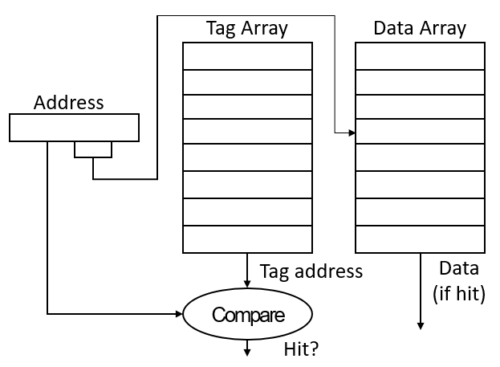
Direct Mapped Cache
Each address can only be stored in one line
Address of request is compared to corresponding entry in tag array
Hit: select appropriate data from line
Miss: invoke replacement policy

Slide 27
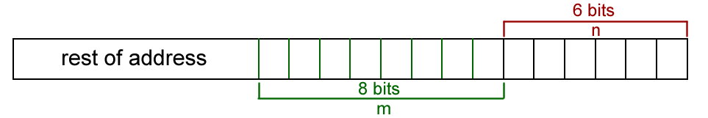
Address use in Direct-mapped Cache
Caches operate on “lines”, Caches lines are a power of 2 in size. They contain multiple words of memory, usually between 16 and 128 bytes
Line size: 2^{n} bytes
If n = 6 bits Line size = 64 bytes
Common cache line sizes are 32, 64 and 128 bytes.
Cache size 2^{m} lines
If m = 8 Cache size = 256 lines (256x64 ~ 16kb)
Bottom m + n bits are used
Tag entry given by m bits is returned and compared with address ignoring n bottom bits
If hit bottom n bits used to select correct byte from line

Slide 28
Implementation of Tag Arrays
Tag array has same number of entries as lines in cache
Tags contain information to identify addresses stored in corresponding entry in cache
Each entry is size of address (in bits) less m+n
Plus bits for valid, dirty, and reference
V | D | R | Tag Entry
V bit: set to 0 if line deliberately removed from cache
D bit: 0 when line first occupied – set to 1 if line written to
R bit: set to 1 when line referenced & all other R bits cleared

Slide 29
Data Arrays
Structure similar to tag array
Array outputs all lines that might contain the address requested
If hit occurred
Select line corresponding to tag entry that hit
Use least significant bits to select correct byte within the line

Slide 30
Replacement Policy
Fully associative caches have to choose which line to evict (get rid of) when a new line is brought into the cache
Optimal to replace line that will be referred to furthest in future
Random replacement has been used
Least recently used (LRU) gives better performance than random
Needs hardware to keep track of use
Not recently used
Remove (evict) a line not used in immediate past
Track only most recently used and evict random line from others

Slide 31
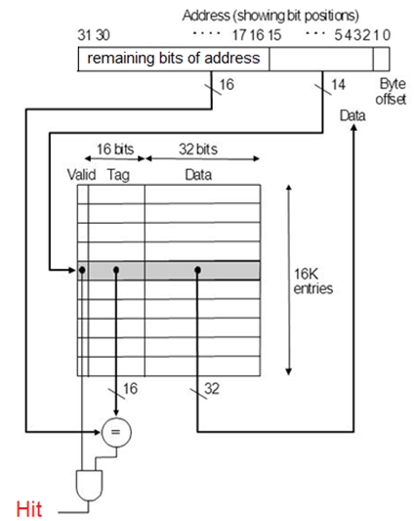
Hit/Miss Logic
Compare remaining bits of address with tag entry
If bits match and valid bit is set
Hit

Slide 32
Data-mapped Cache: Example
Offset | Tag | Data
0 | 01FF | Data for 01FF0000 to 01FF00FF
1 | 020F | Data for 029F0100 to 020F01FF
--- | ---
A0 | 00A4 | Data for 00A4A000 to 00A4A0FF
A1 | 0876 | Data for 0876A100 to 0876A1FF
--- | ---
FF | 090A | Data for 090AFF00 to 090AFFFF
Assume m = n = 8 i.e. 256 lines each of 256 bytes
Address 00A4A0B1 requested
Tag stored at A0 ~ m
Rest of address is 00A4
And if valid bit (V) =1
Hit!
Successive addresses 00A4A000 up to 00A4A0FF all hit
Return data from offset B1 ~ n in line

Slide 33
Write-back vs Write-through Caches
Write-through cache: write data in both cache and in main memory
Data in the cache always consistent with main memory
Evicted lines can be overwritten immediately
With write-through, the main memory always has an up-to-date copy of the line. So when a read is done, main memory can always reply with the requested data.

Slide 34
Write-back vs Write-through Caches
Write-back cache: write data in cache only also called a copy-back cache.
Sometimes the up-to-date data is in a processor cache, and sometimes it is in main memory. If the data is in a processor cache, then that processor must stop main memory from replying to the read request, because the main memory might have a stale copy of the data
When cache line evicted, write data back to main memory
Extra delay
Usually more efficient
because it reduces the number of write operations to main memory.

Slide 35
Cache Miss
Cache Miss Types
compulsory: caused by first reference to line not in cache (an empty cache)
capacity : program refers to more memory than cache holds capacity.
conflict : several blocks are mapped to the same set or block frame; also called collision misses (Two blocks are mapped to the same location and there is not enough room to hold both)
Reducing Cache Misses
Capacity & conflict misses can be reduced by increasing cache size or by moving to fully associative cache
Prefetching: attempts to reduce compulsory misses by predicting which lines will be required and putting them in the cache (More).
Cache Miss: More

Slide 36
Cache Example
Trace: 132,133,134,280,400,135,136
132,133,134,284,404,
Assume cache has lines of 32 words
Initially empty
Trace of addresses accessed
Address | Content
- | -
- | -
- | -
- | -
Address | Content
128-159 | Program Code
- | -
- | -
- | -
Address | Content
128-159 | Program Code
256-287 | Data
- | -
- | -
Address | Content
128-159 | Program Code
256-287 | Data
384-415 | Data
- | -
132 – Miss read line 128-159
133 – hit
134 – hit
280 – Miss read line 256-287
400 – Miss read line 384-415
Each line has size of 32 words, that means. If an address requested, then the whole addresses within that line are placed in the memory:
e.g. Trace 132 requested
The first time a block is referenced it will cause a cache miss. So, 132 causes a miss and has the effect of bringing addresses 128 ...159 into the cache.
128 + 32 = 160 words
Range = 128 …. 159
Note: show the slide in the run time mode to see the example in an animation mode.
135 – hit
136 – hit
132 – hit
133 – hit
134 – hit
284 – hit
404 – hit

Slide 37
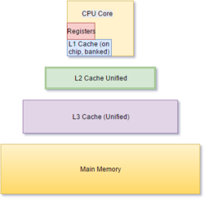
Multilevel Caches
Modern machines have several levels of cache
First and second level caches are usually on chip
Each level needs to have a larger capacity than the level above it
Processor
First Level (L1 Cache)
Second Level (L2 Cache)
Third Level (L3 Cache)
Main Memory

Slide 38
Replacement Policy
Not Recently Used only tracks most recently used
Ref line 2
Ref line 2
Ref line 3
Ref line 4
Ref line 2
Use | Line
0 | Line 1
0 | Line 2
0 | Line 3
1 | Line 4
Use | Line
0 | Line 1
1 | Line 2
0 | Line 3
0 | Line 4
Use | Line
0 | Line 1
0 | Line 2
1 | Line 3
0 | Line 4
Use | Line
0 | Line 1
0 | Line 2
0 | Line 3
1 | Line 4
Use | Line
0 | Line 1
1 | Line 2
0 | Line 3
0 | Line 4

